Slide 1

Shaoming Zhang
Computer Vision and Remote Sensing Group, Tongji University
Lecture Note of
Pattern Recognition and Machine Learning
Chapter 8: graphical models (2)

Slide 2
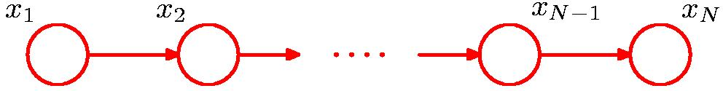
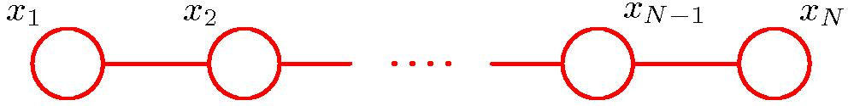
Converting Directed to Undirected Graphs (1)

Slide 3
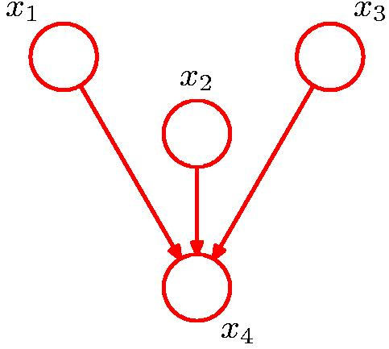
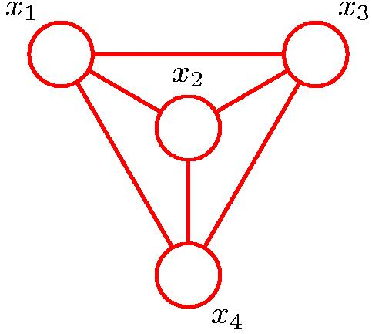
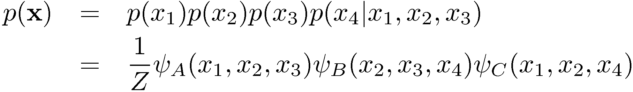
Converting Directed to Undirected Graphs (2)
Additional links， moralization：结婚后才能生孩子

Slide 4
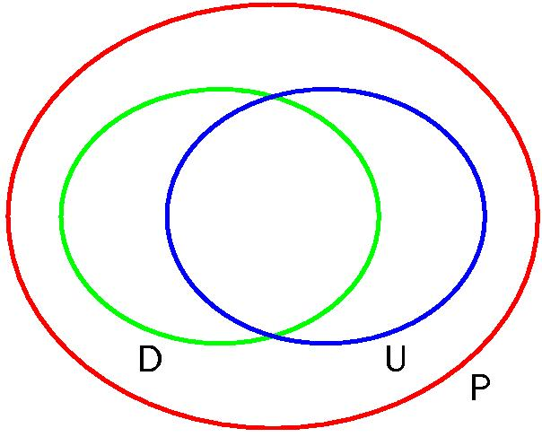
Directed vs. Undirected Graphs (1)
If every conditional independence property of the distribution is reflected in the graph, and vice versa,
every conditional independence statement implied by the graph is satisfied by the specific distribution,
The graph is said to be a perfect map for that distribution.
绿色：能够用有向图构建perfect map的分布
蓝色：能够用无向图构建perfect map的分布
红色：所有分布

Slide 5
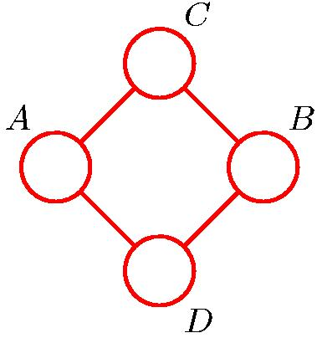
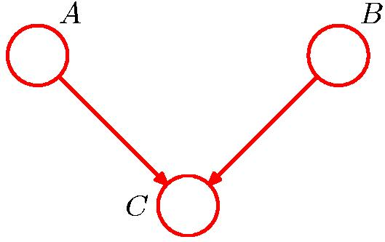
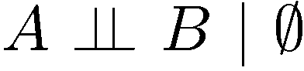
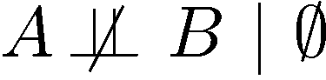
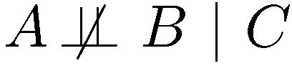
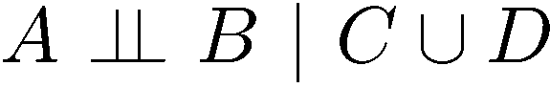
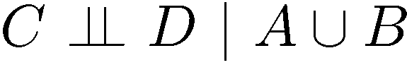
Directed vs. Undirected Graphs (2)
上述条件独立关系不存在无向图描述
上述条件独立关系不存在有向图描述

Slide 6
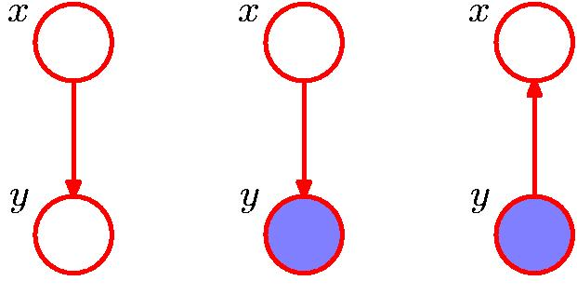
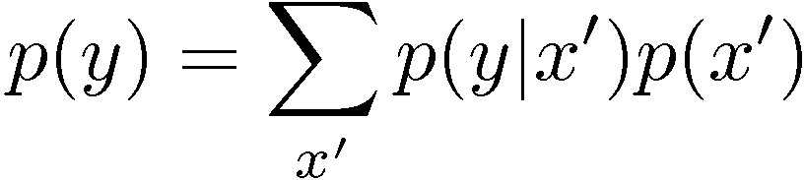
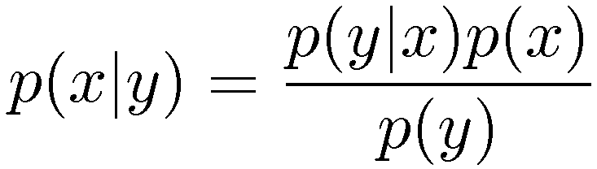
Inference in Graphical Models

Slide 7
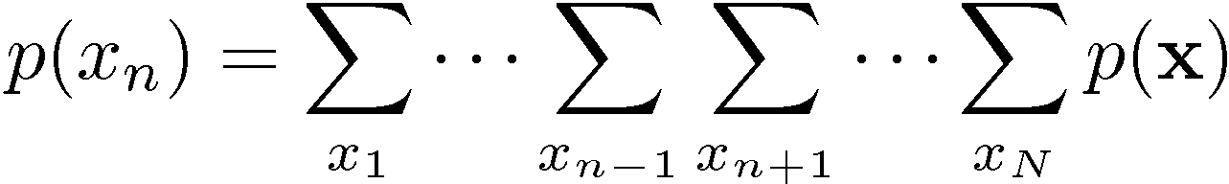
Inference on a Chain

Slide 8
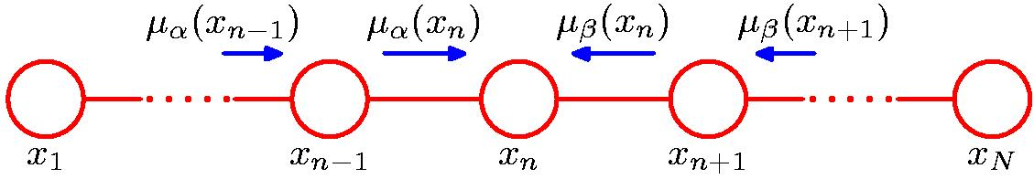
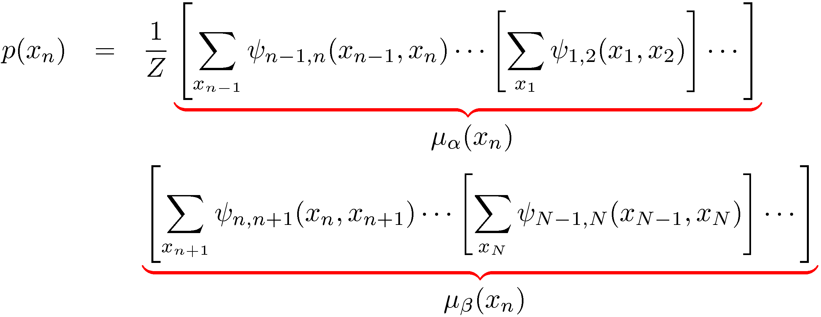
Inference on a Chain

Slide 9
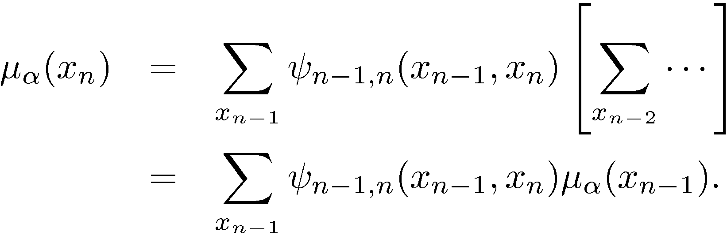
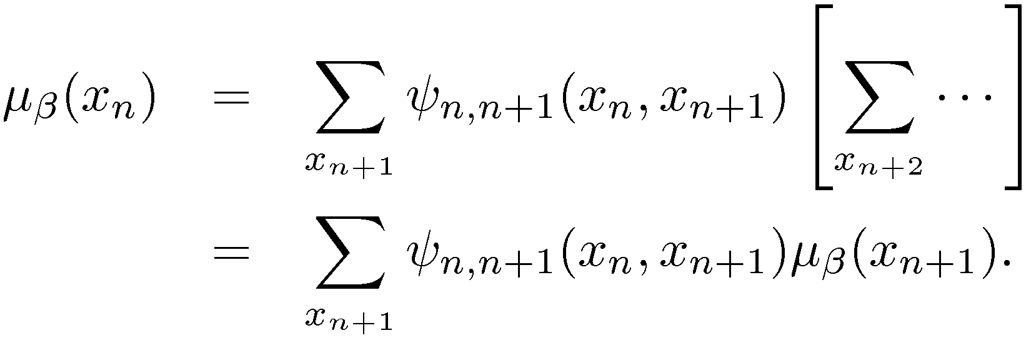
Inference on a Chain

Slide 10
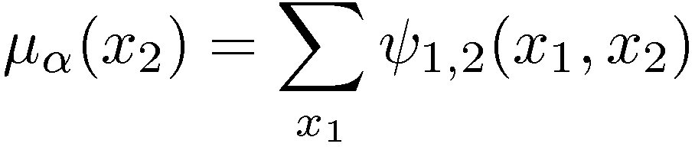
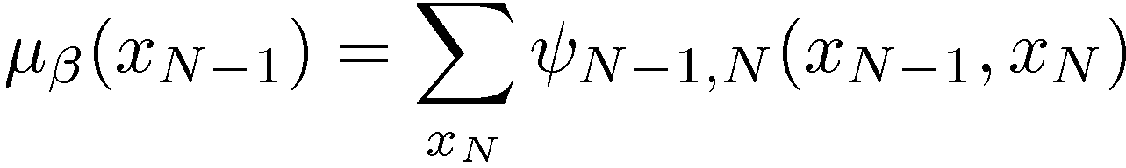
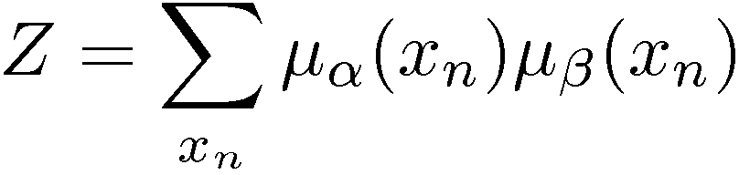
Inference on a Chain

Slide 11
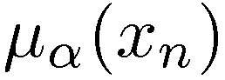
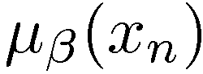
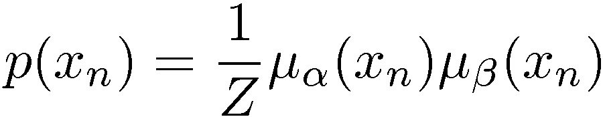
Inference on a Chain
To compute local marginals:
Compute and store all forward messages, .
Compute and store all backward messages, .
Compute Z at any node x_{m}
Compute for all variables required.

Slide 12
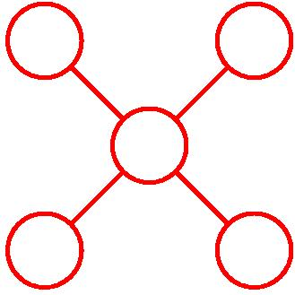
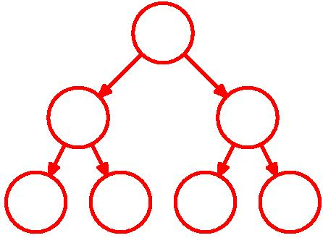
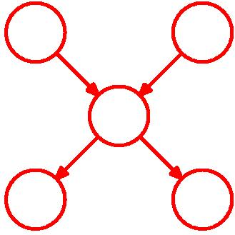
Trees
Undirected Tree
Directed Tree
Polytree

Slide 13
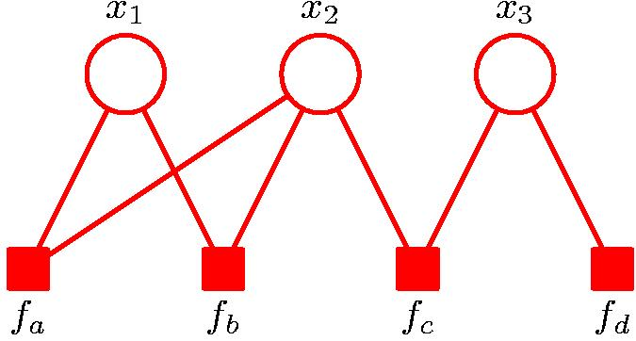
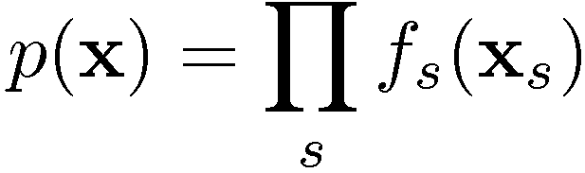
Factor Graphs

Slide 14
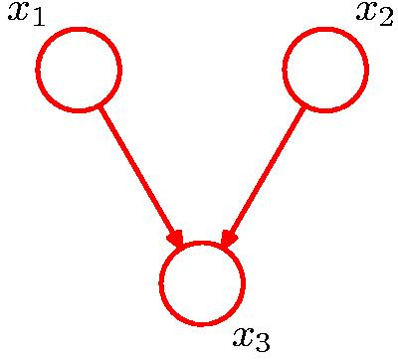
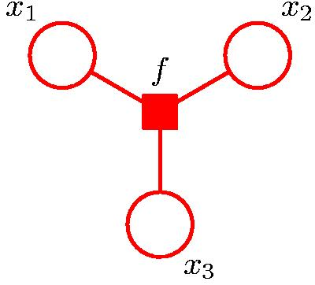
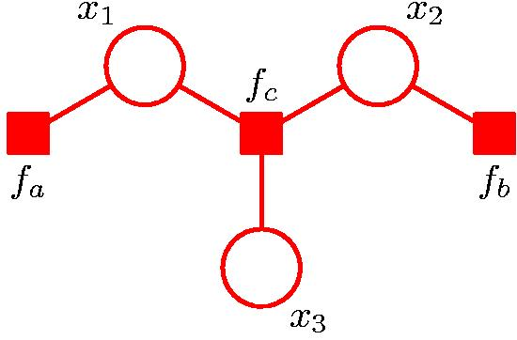
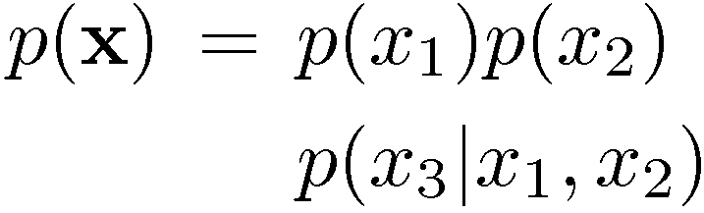
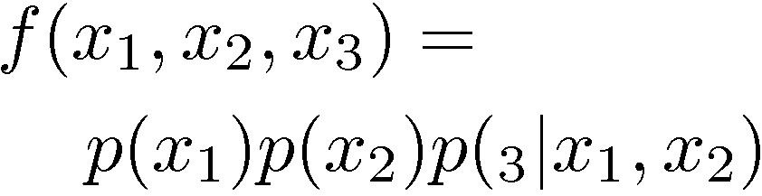
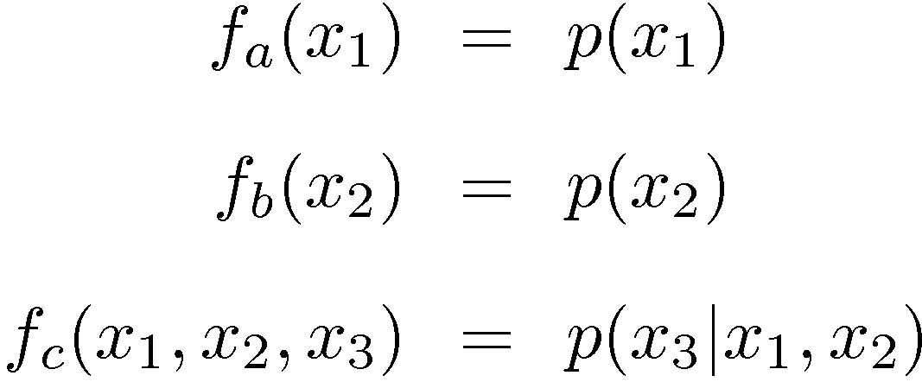
Factor Graphs from Directed Graphs

Slide 15
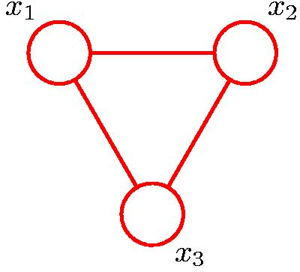
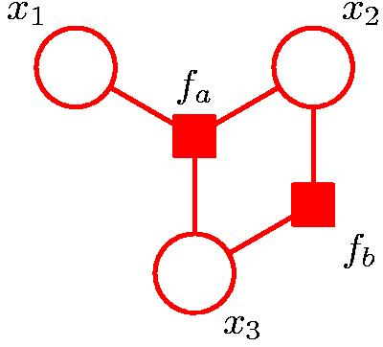
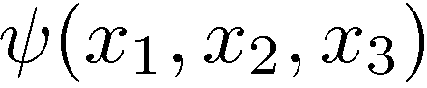
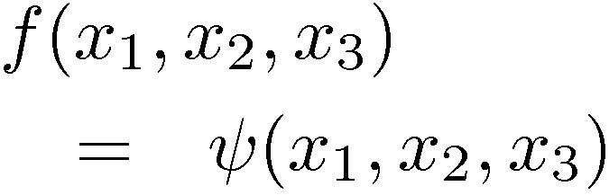
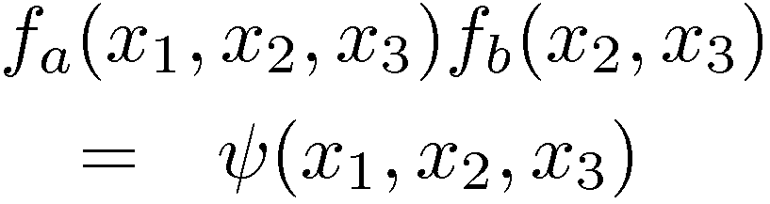
Factor Graphs from Undirected Graphs

Slide 16
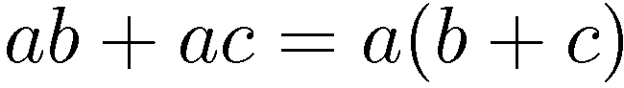
The Sum-Product Algorithm (1)
Objective:
to obtain an efficient, exact inference algorithm for finding marginals;
in situations where several marginals are required, to allow computations to be shared efficiently.
Key idea: Distributive Law

Slide 17
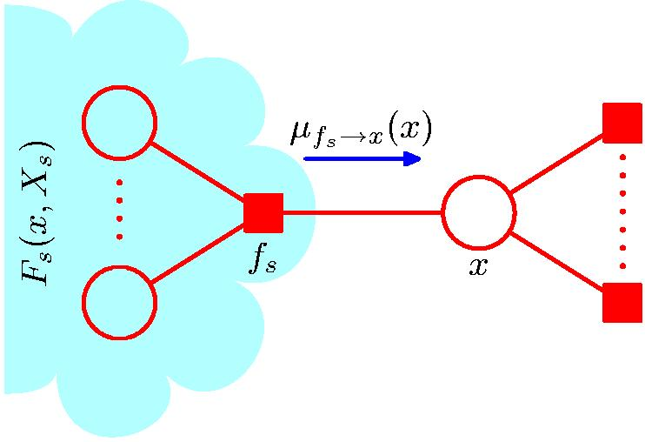
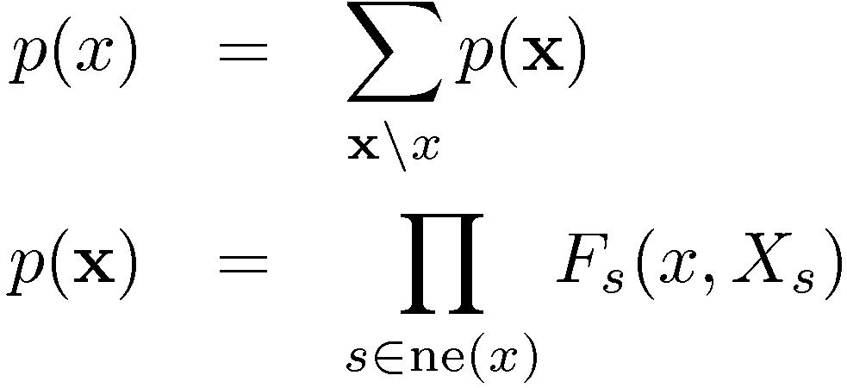
The Sum-Product Algorithm (2)
核心概念：先分组 ，再探寻分组后是否具有递归性质
以x变量节点为中心，把所有节点按照与x相邻的factor节点的关联性分组。
X_{s}表示通过f_{s}与x相连接的所有变量节点的集合（此处的连接包括直接和间接）
F_{s}(x, X_{s}) 表示所有与f_{s} 关联的因式的乘积（所有直接或间接通过f_{s}与x关联的因式）
The product of all the factors in the group associated with factor f_{s}

Slide 18
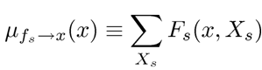
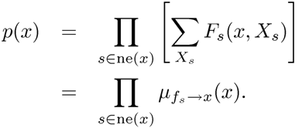
The Sum-Product Algorithm (3)
对于x\x求和
由于F_{s}(x, X_{s}) 只依赖于X_{s}
因此sum与product可以交换顺序
将sum部分定义为message（f->x）

Slide 19
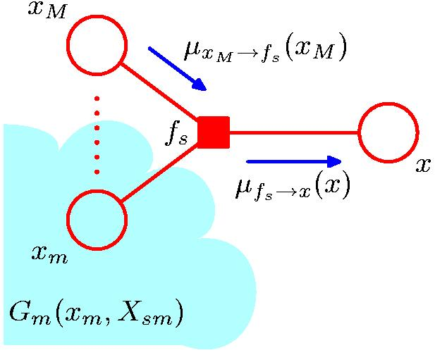
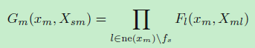
The Sum-Product Algorithm (4)
由于F_{s}(x, X_{s})包含所有与f_{s} 关联的因式的乘积（直接或间接），所以他可分解为直接连接部分和间接连接的部分。间接连接部分为sub-group，用G表示。即F为fs和G的组合的表达式。
Sub-group 可继续分解，分解形式如下，
即G可再次分解为F的表达式。

Slide 20
The Sum-Product Algorithm (4)
任一变量的边缘分布是所有相邻因式传递给变量的消息的乘积
递归形式
不停的征求所有非x节点对x的概率的建议，直至搜集到所有的非x节点的建议。Message即Belief

Slide 21

The Sum-Product Algorithm (4)
把 μ_{fs->x} 表达式内的求和再次分解

Slide 22
The Sum-Product Algorithm (5)

Slide 23

The Sum-Product Algorithm (6)

Slide 24


The Sum-Product Algorithm (7)
Initialization

Slide 25
The Sum-Product Algorithm (8)
To compute local marginals:
Pick an arbitrary node as root
Compute and propagate messages from the leaf nodes to the root, storing received messages at every node.
Compute and propagate messages from the root to the leaf nodes, storing received messages at every node.
Compute the product of received messages at each node for which the marginal is required, and normalize if necessary.

Slide 26

Sum-Product: Example (1)

Slide 27


Sum-Product: Example (2)

Slide 28


Sum-Product: Example (3)

Slide 29

Sum-Product: Example (4)

Slide 30

The Max-Sum Algorithm (1)
Objective: an efficient algorithm for finding
the value x^{max} that maximises p(x);
the value of p(x^{max}).
In general, maximum marginals ≠ joint maximum.

Slide 31


The Max-Sum Algorithm (2)
Maximizing over a chain (max-product)

Slide 32

The Max-Sum Algorithm (3)
Generalizes to tree-structured factor graph
maximizing as close to the leaf nodes as possible

Slide 33

The Max-Sum Algorithm (4)
Max-Product → Max-Sum
For numerical reasons, use
Again, use distributive law

Slide 34
The Max-Sum Algorithm (4) cont’
与sum-product类似，max操作和求和一样可分解

Slide 35



The Max-Sum Algorithm (5)
Initialization (leaf nodes)
Recursion
Φ(x)是x的表达式，即当消息最大时的x₁,x₂…x_{M}都是x的函数，因为不对x求最大值。
例如：f(x,y) = x²y+2x; 对x求极值，求导为零得 2xy+2=0 ; x = -1/y
可能有不同的configuration使联合概率最大。因此Φ(x)必须记录的，以确定configuration。
例如： Φ₁和Φ₂都可使μ_{f->x}(x_{n})达到最大，之后对x_{n}最大化，Φ₁对应的令联合概率最大的x_{n}值为v1， Φ₂对应的令联合概率最大的x_{n}值为v2，并且两个联合概率最大值相等。则两个configuration为（ Φ₁ （v1），v1）和（ Φ₁ （v2），v2）。

Slide 36


The Max-Sum Algorithm (6)
Termination (root node)
Back-track, for all nodes i with l factor nodes to the root (l=0)

Slide 37


The Max-Sum Algorithm (7)
Example: Markov chain，逐个倒推

Slide 38
Chain，消息都是一对一传递
Tree，消息是多对一传递
在max-product/sum算法中，
Chain，叶子的值由root一对一计算。
Tree，多个叶子的值由一个root计算而得到。

Slide 39
What if the graph is not a tree
Several alternative methods:
Gibbs sampling
Expectation Maximization
Variational methods
Elimination Algorithm
Junction-Tree algorithm
Loopy Belief Propagation

Slide 40
The Junction Tree Algorithm
Exact inference on general graphs.
Works by turning the initial graph into a junction tree and then running a sum-product-like algorithm.
Intractable on graphs with large cliques.

Slide 41
Loopy Belief Propagation
Graphs with loops
Sum-Product on general graphs.
Initial unit messages passed across all links, after which messages are passed around until convergence (not guaranteed!).
Approximate but tractable for large graphs.
Sometime works well, sometimes not at all.

